Slide 1
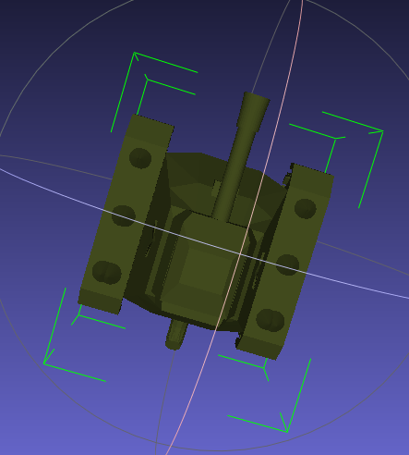
glm::vec2 posXY;
float angle: -- Up is 0, +VE clock-wise
void Move(float howMuch)

Slide 2
glm::vec2 posXY;
float angle: -- Up is 0, +VE clock-wise
void Move(float howMuch)
Check what quadrant you are in (0-90, 90-180, etc.)
Do trig magic to convert the angle to the X Y location of where it’s pointing.
This will give you a location where the tank will be.
Normalize this direction
Multiple this “direction” and multiply by the velocity.

Slide 3
?,?,0
glm::vec2 posXY;
float angle: -- Up is 0, +VE clock-wise
void Move(float howMuch)
glm::mat4 matRotateY = glm::rotate(glm::mat4(1.0f), angle);
// vertexWorldPos = matModel * vec4( vPos.xyz, 1.0f);
Vec3 directionForward = vec3(0, 1, 0);
Vec4 doHere = matModel * vec4(directionForward, 1);
This will give you a location where the tank will be.
Normalize this direction
Multiple this “direction” and multiply by the velocity.
1 unit
Y-axis
0,0,0
X-axis

